Slide 1
Chapter 1: Getting Started with Hibernate

Slide 2
Learning Objectives
Getting Started with Hibernate
Concepts of ORM (Object Relational Mapping)
Advantages of Hibernate compared to JDBC
Hibernate Architecture
Installation and Directory Structure
Hibernate Configurations

Slide 3
Hibernate - Overview
Hibernate framework simplifies the development of java application to interact with the database. Hibernate is an open source, lightweight, ORM (Object Relational Mapping) tool.
An ORM tool simplifies the data creation, data manipulation and data access. It is a programming technique that maps the object to the data stored in the database.
Hibernate maps Java classes to database tables and from Java data types to SQL data types and relieve the developer from 95% of common data persistence related programming tasks.

Slide 4
Hibernate - Advantages
There are many advantages of Hibernate Framework. They are as follows:
Open-source and Lightweight: Hibernate framework is open-source under the LGPL license and lightweight.
Fast performance: The performance of hibernate framework is fast because cache is internally used in hibernate framework. There are two types of cache in hibernate framework first level cache and second level cache. First level cache is enabled bydefault.
Database Independent query: HQL (Hibernate Query Language) is the object-oriented version of SQL. It generates the database independent queries. So you don't need to write database specific queries. Before Hibernate, If database is changed for the project, we need to change the SQL query as well that leads to the maintenance problem.
Automatic table creation: Hibernate framework provides the facility to create the tables of the database automatically. So there is no need to create tables in the database manually.
Simplifies complex join: To fetch data form multiple tables is easy in hibernate framework.
Provides query statistics and database status: Hibernate supports Query cache and provide statistics about query and database status.

Slide 5
Supported Databases
HSQL Database Engine
DB2/NT
MySQL
PostgreSQL
FrontBase
Oracle
Microsoft SQL Server Database
Sybase SQL Server
Informix Dynamic Server

Slide 6
Hibernate Architecture

Slide 7
Hibernate Architecture Explained
SessionFactory
The SessionFactory is a factory of session and client of ConnectionProvider. It holds second level cache (optional) of data. The org.hibernate.SessionFactory interface provides factory method to get the object of Session.
Session
The session object provides an interface between the application and data stored in the database. It is a short-lived object and wraps the JDBC connection. It is factory of Transaction, Query and Criteria. It holds a first-level cache (mandatory) of data. The org.hibernate.Session interface provides methods to insert, update and delete the object. It also provides factory methods for Transaction, Query and Criteria.

Slide 8
Hibernate Architecture Explained
Transaction
The transaction object specifies the atomic unit of work. It is optional. The org.hibernate.Transaction interface provides methods for transaction management.
ConnectionProvider
It is a factory of JDBC connections. It abstracts the application from DriverManager or DataSource. It is optional.
TransactionFactory
It is a factory of Transaction. It is optional.

Slide 9
Add Maven Dependencies for Hibernate - IntelliJ Idea

Slide 10
Add Maven Dependencies for Hibernate - Eclipse

Slide 11
Hibernate Basic Example
Here is a practical code example of getting started with hibernate.
It demonstrates a basic example of:
Using XML based configuration for providing data model mapping details.
Using JPA annotations, so that we don’t need to provide mapping in separate XML file.

Slide 12
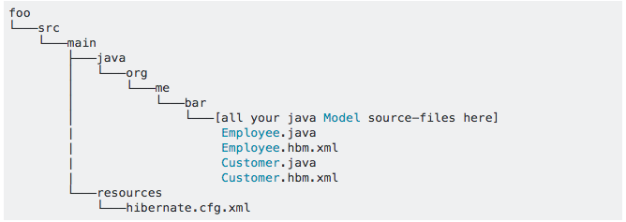
Hibernate Directory Structure
You should put the "hibernate.cfg.xml" under "/src/main/resources”.
You should put all the model-mapping files under the same directory that you define the POJO model classes.
And you should reference/map all your Model files in your hibernate.cfg.xml file like below:

Slide 13
Hibernate Directory Structure
Here is an example project structure with Hibernate mappings and configurations.

Slide 14
What are we learning in Next Chapter ?
You will learn about Working with Hibernate
We will learn about:
Hibernate Data Types.
Exploring Hibernate API
Configuration xml file and Mapping xml file along with dtds.
Introduction to JPA Annotations
Persistent Classes (POJO)

Slide 15
Thank You !

